Slide 1
C10.b Capstone Workshop

Slide 2
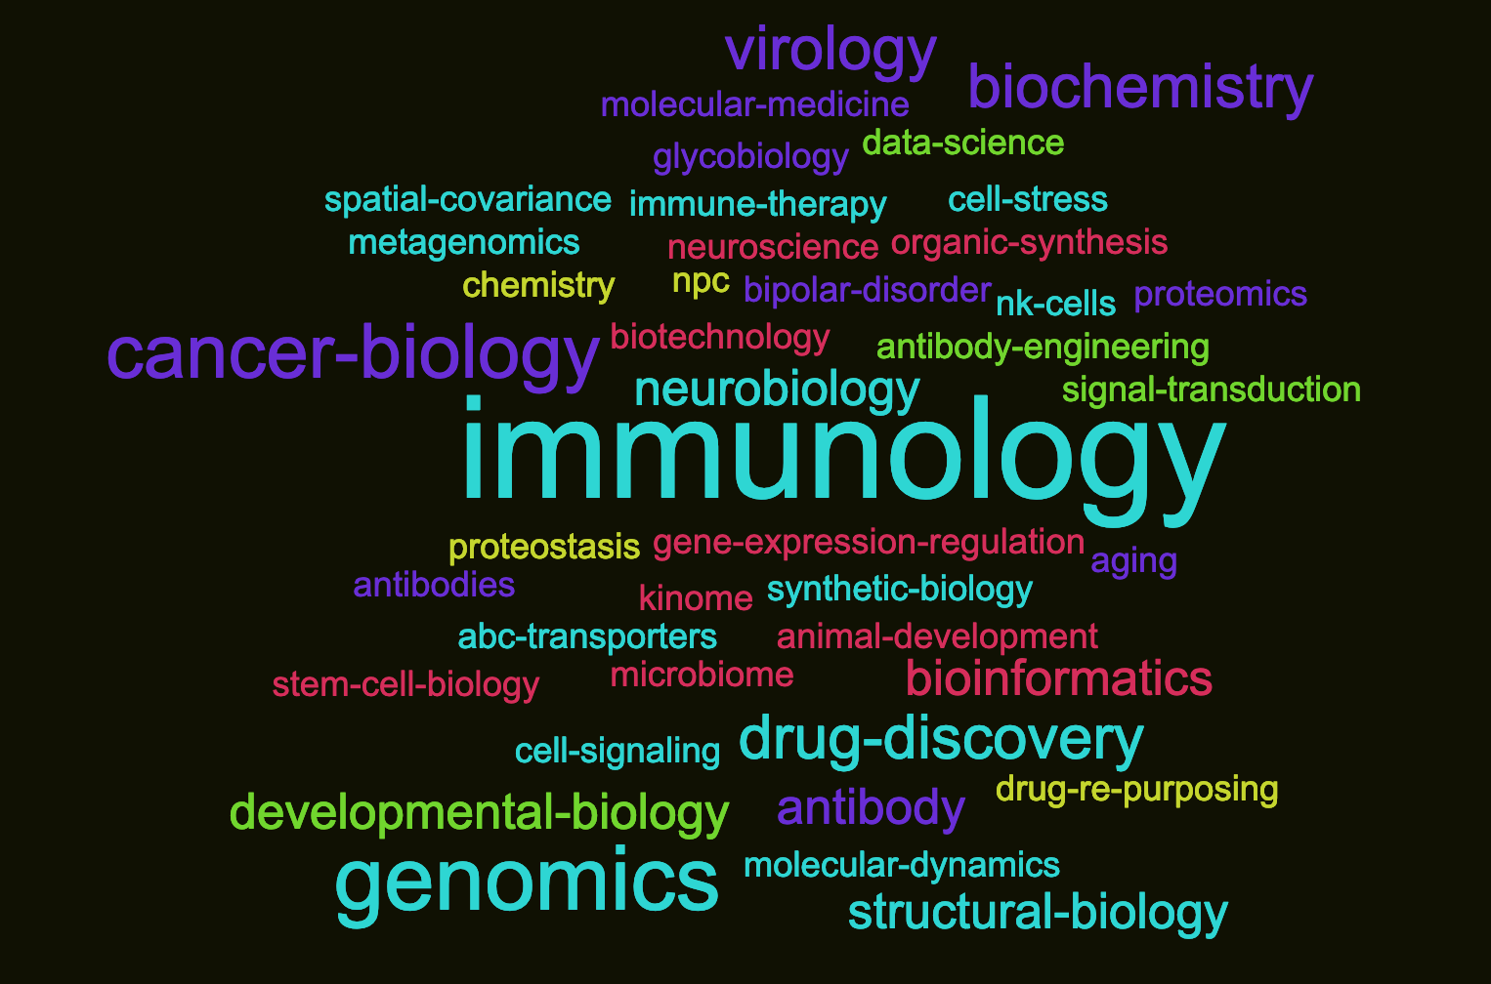
What does it mean to do bioinformatics?

Slide 3
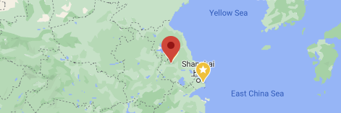
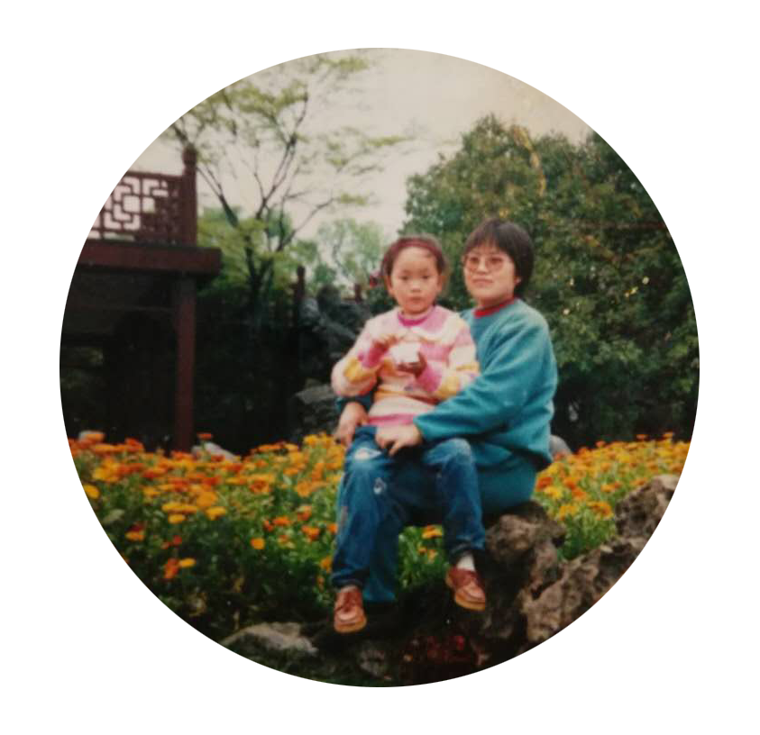


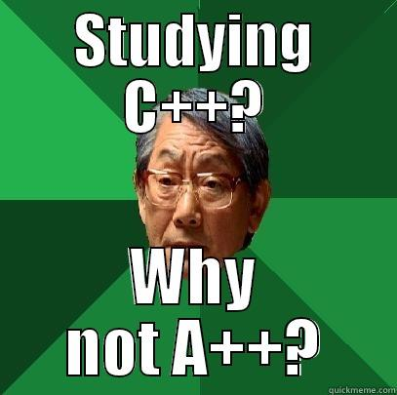
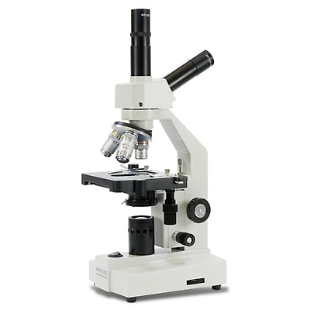
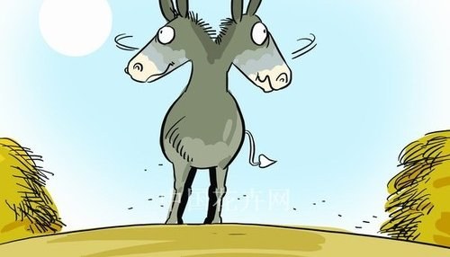
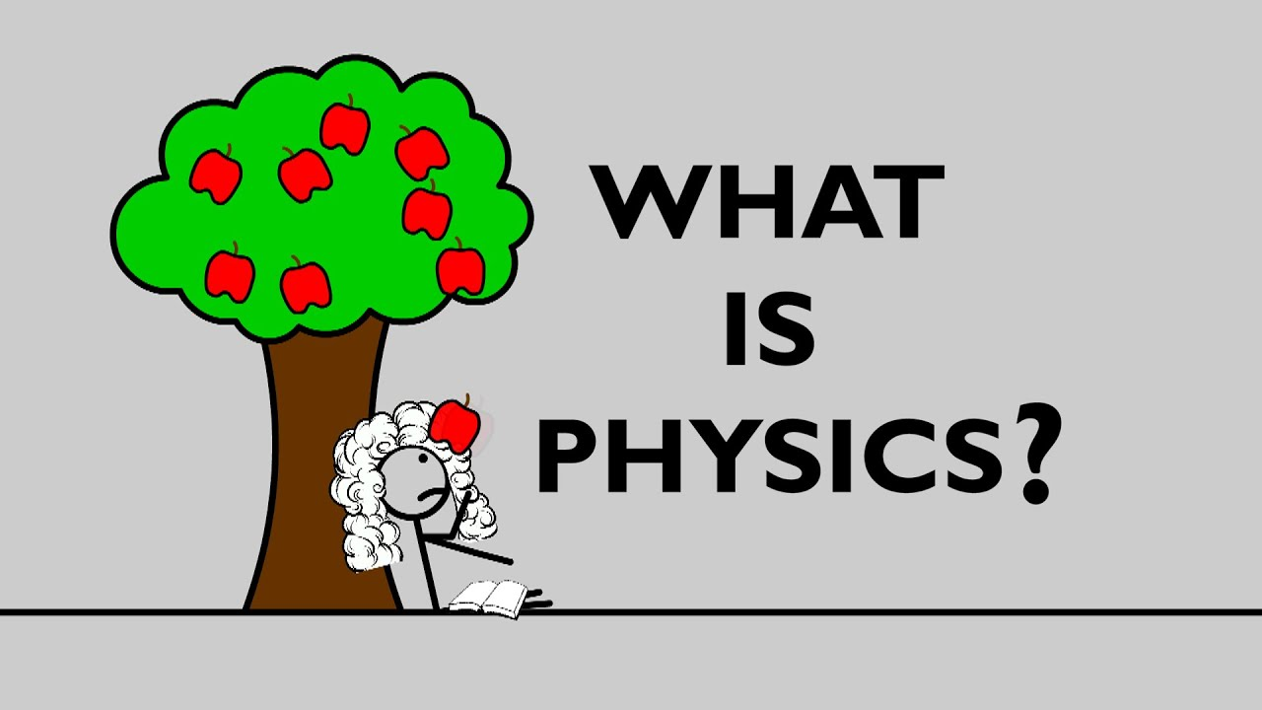
A
Fig.1: (A) I was born in Yangzhou city, China. My mom is a math teacher, and my dad teaches computer science. (B) I learned some basic programming with my dad, some more programming in high school & later in college as well. I never thought I would need to use it for anything other than getting a few more credits and As. (C) I loved every science subject: math, physics, chemistry, biology. At the end of high school, it was difficult for me to determine which subject I liked more. My parents bought me a microscope when I was 10 yo; maybe that contributed to my interest in bioscience (which became my major in college).
Yangzhou City
B
C
Figure 1. Back in the 90s. Computer + bioscience was not a thing, as far as I know.
Huitian (Yolanda) Diao
Huitian (Yolanda) Diao

Slide 4
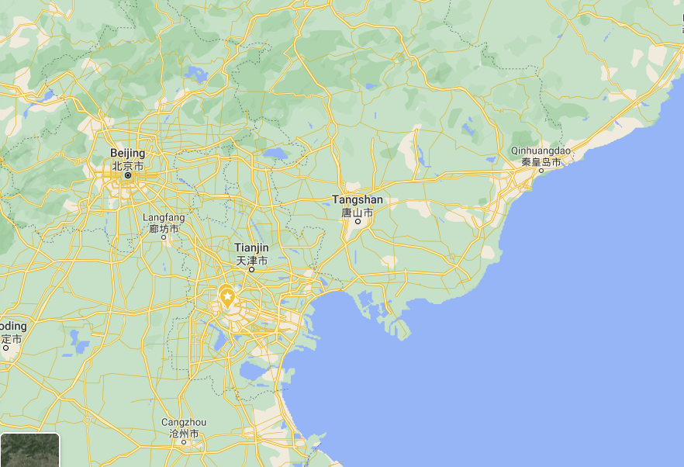
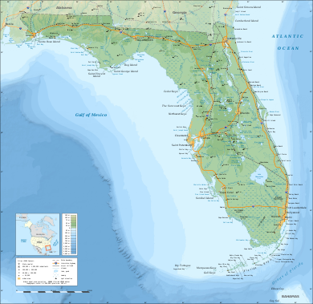
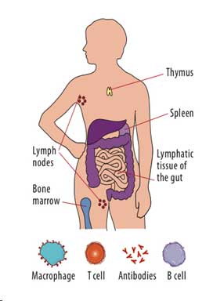
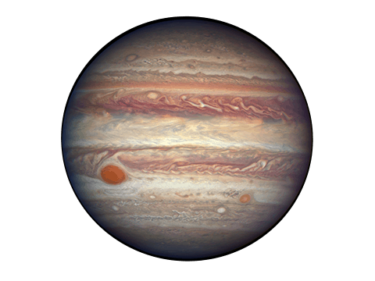
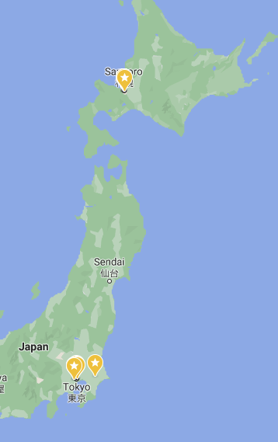
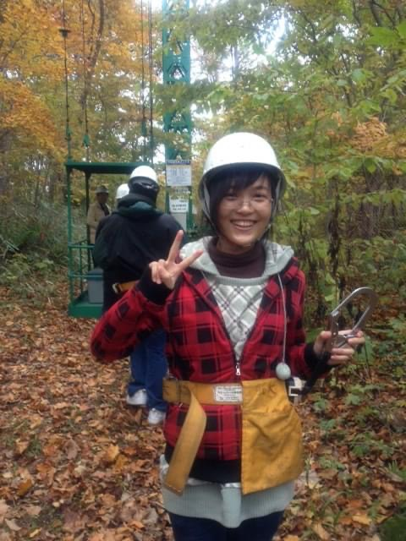

A
C
D
Fig.2: (A, B) I went off to college far away from home to make my parents proud empty nesters. There I shuffled between different research labs. Even in bioscience there were so many fascinating subjects, it was hard for me to find a direction again. I obtained a scholarship to do research in forestry in Hokkaido University for one year. Then I took a gap year at Peking University in Dept of Immunology, where I decided that immunology is my true passion. (C) I came to Jupyter ? / Jupiter Florida: an interesting place with many palm trees. (D) Immunology is extremely hard, it took me years to understand that nobody actually understands it. (E) Yeah, it’s 21st century you simply can’t do immunology without bioinformatics. I had no experience with R / Python before, so it all started here at Scripps Research!
Gap year
College
B
E
ONE DOES NOT SIMPLY
Exchange researcher
STUDY IMMUNOLOGY WITHOUT NGS
Figure 2. The modern days. Finding the research field to pursue was a confusing & challenging journey. But I believe immunology & bioinformatics is the way to go!
Huitian (Yolanda) Diao

Slide 5
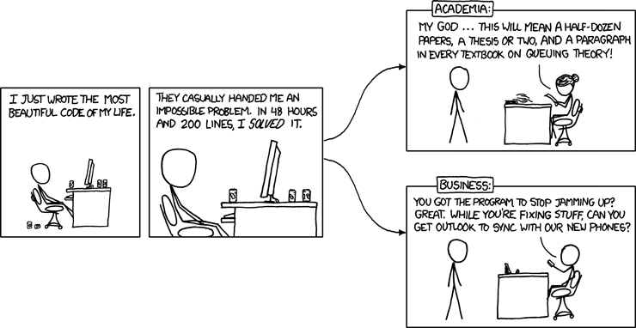
Karthik
https://xkcd.com/664/
Research
…...
Undergrad
Grad school …..
Random acts of programming
Scaling
Su Lab
Andersen Lab + Su Lab

Slide 6
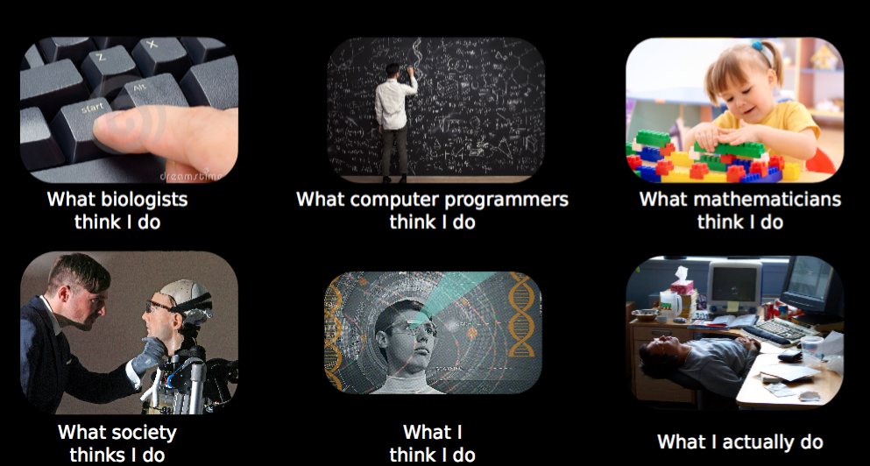
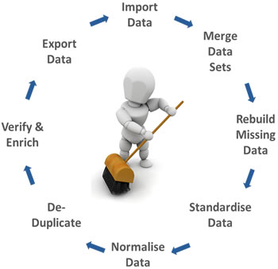
Shaun
https://twitter.com/robamezquita/status/642075132056469504
https://www.edupristine.com/blog/11-facts-about-data-science

Slide 7
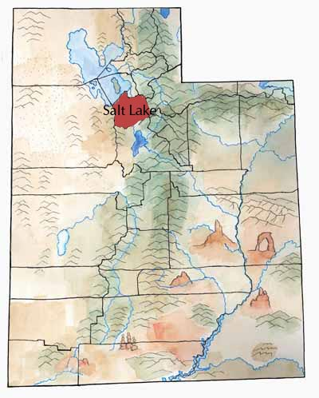
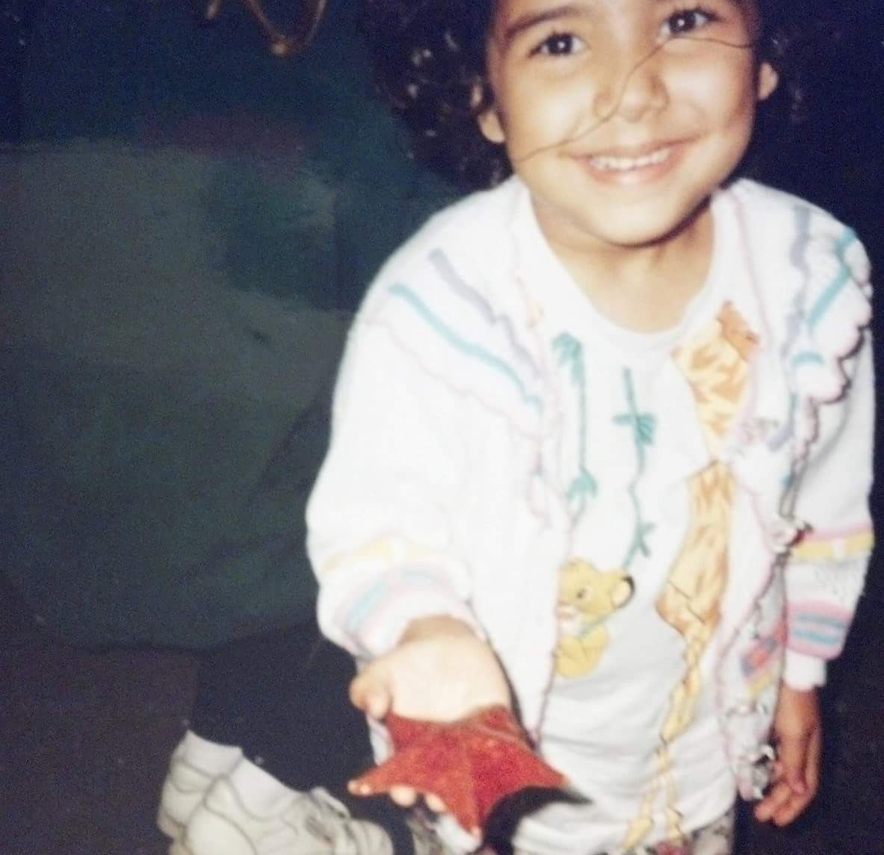
“Be a doctor.”
Eldest of an immigrant family
Nah fam, marine science is also super important for human health!
lol, good luck doing that coming from few resources and in a landlocked state

Slide 8
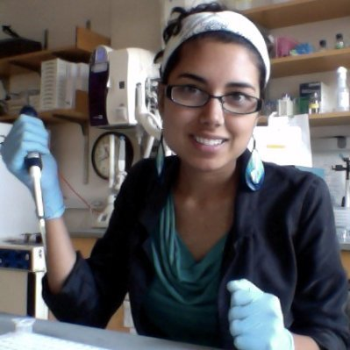
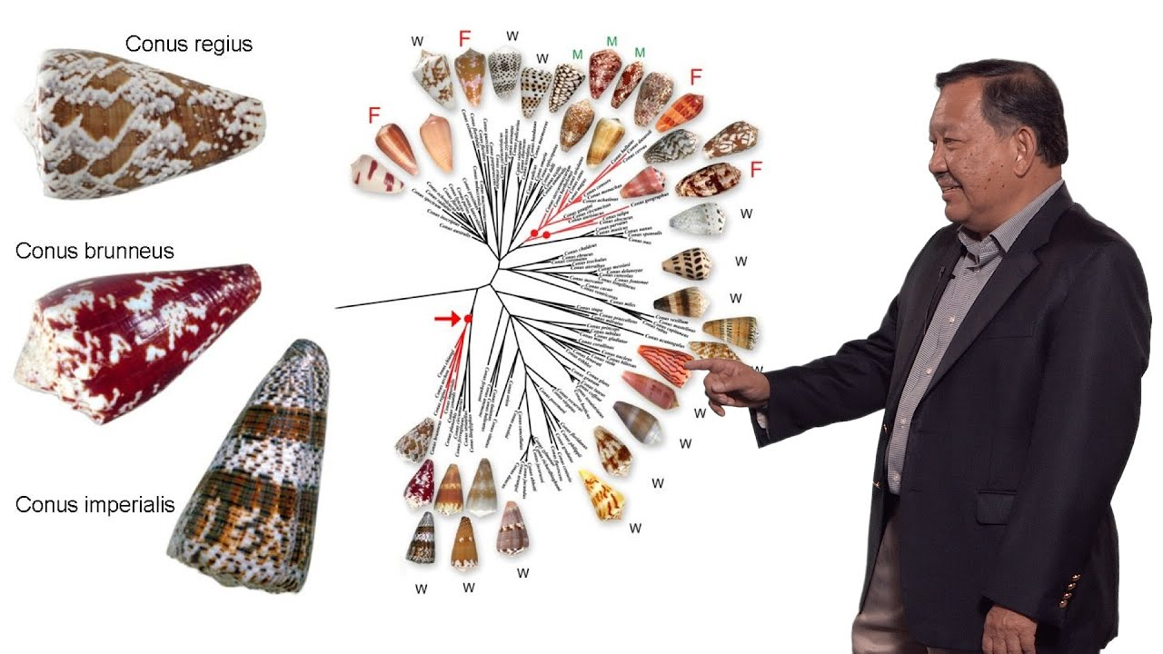
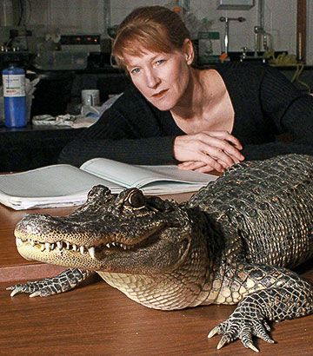
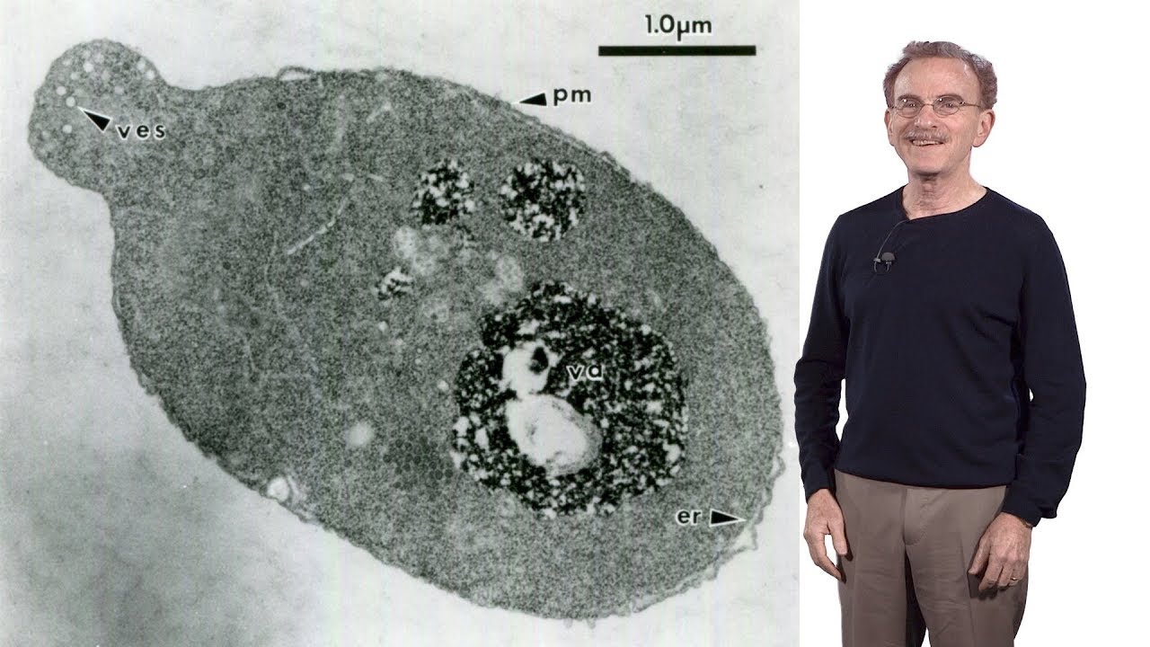
“Be a doctor.”
Eldest of an immigrant family
Thought I’d be doing field work.. but I guess molecular biology is cool!
2007 - 2012 Ecology & Evolution → Molecular Biology

Slide 9
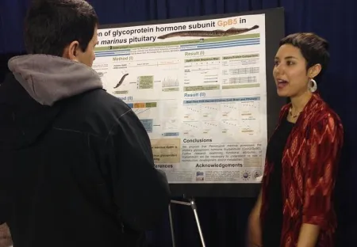
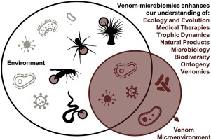
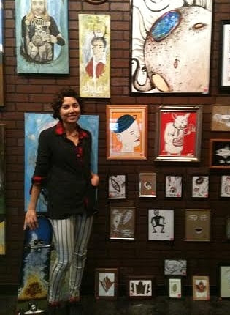
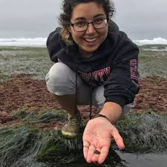
Stay open to different opportunities, and embrace the bumpy road life gives you.
2012 - 2019
Biochem → Quantitative & Systems Biology [Lamprey Neuroendrinology → Venomics]
Here I am in 2014 thinking I’ll never do a job that involves more than 1-2 hours of computer work a day.

Slide 10

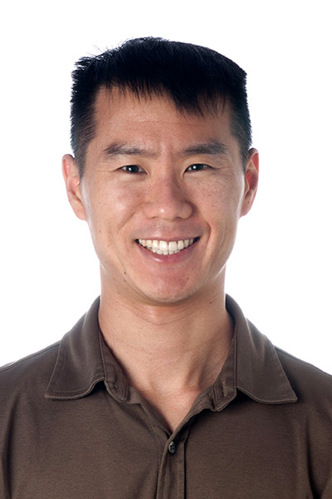
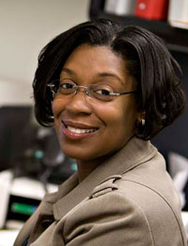
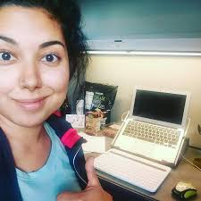
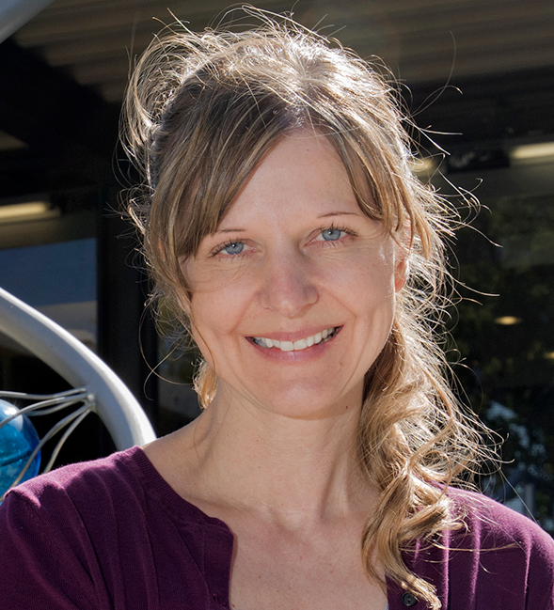
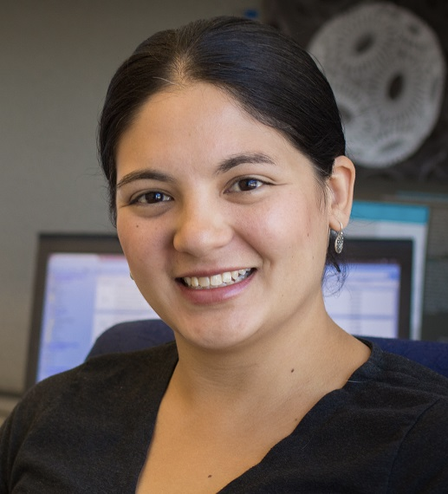
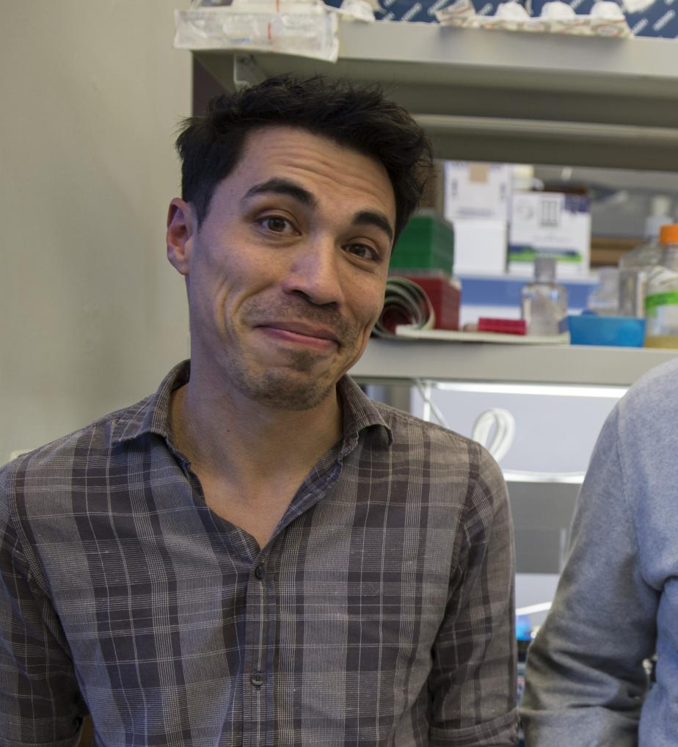
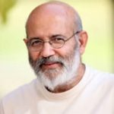
How informative will my data be 50+ years from now?
→ Su Lab, biocuration
Bioinformatics Always learning new things
Work with people you respect and aspire to become, both as a scientist and person

Slide 11
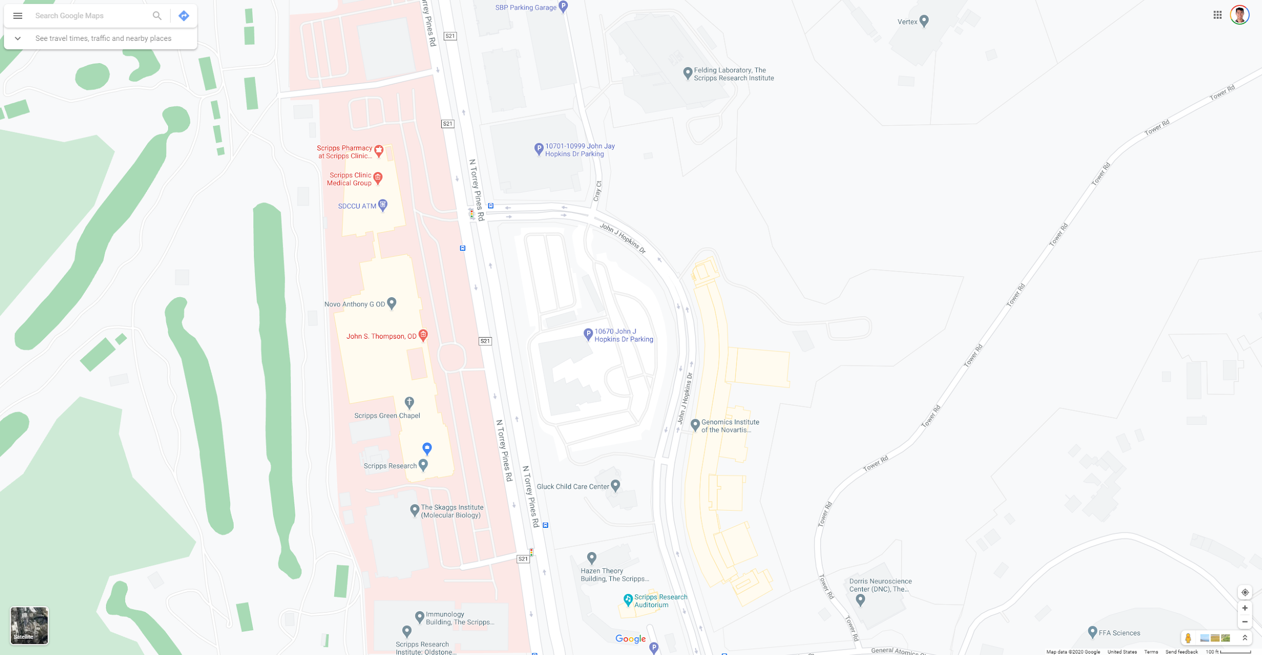
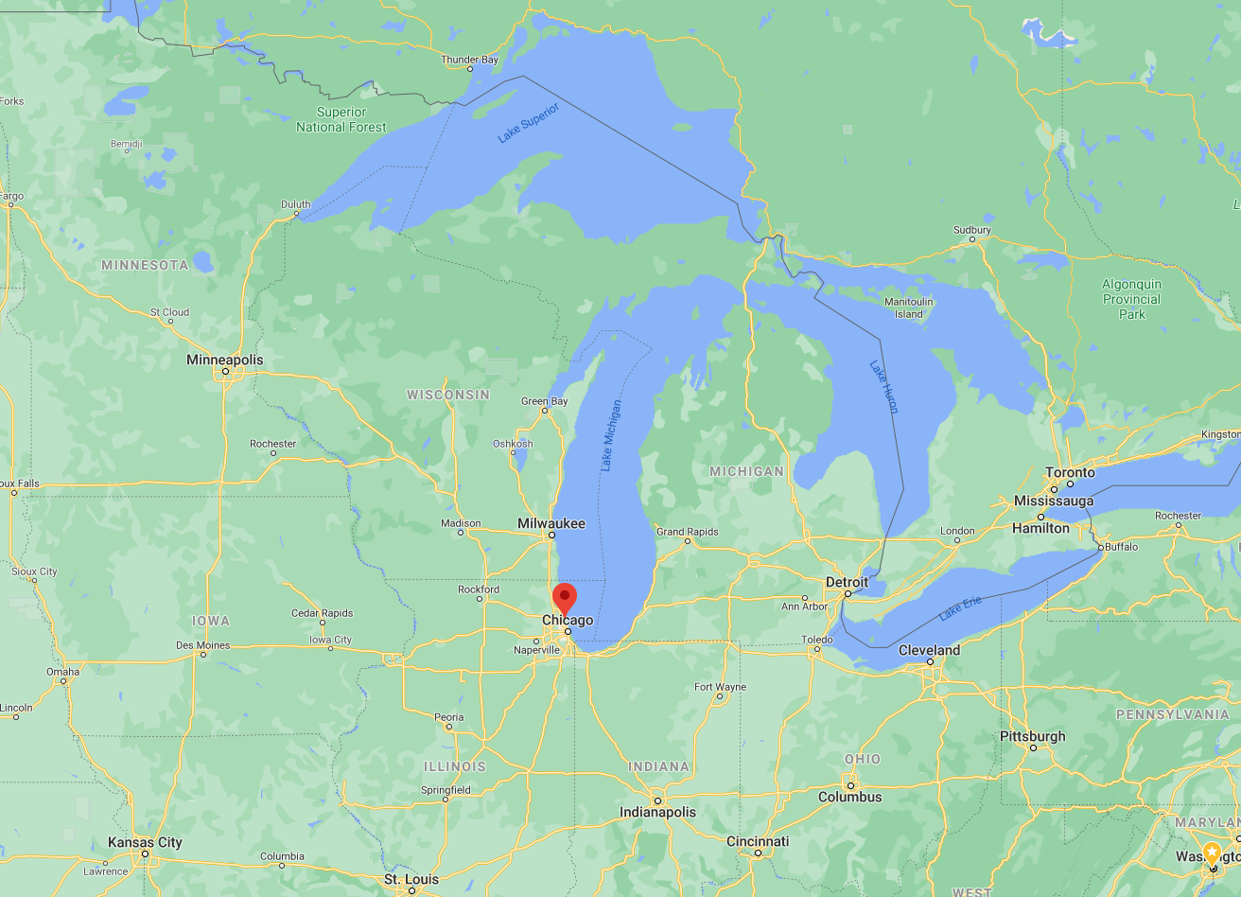

1994 – 1998
BA, Chemistry / Comp Sci
Northwestern University
2011 – present
(Assoc) Professor
Scripps
2002 – 2011
Group Leader
GNF / Novartis
1998 – 2002
Ph.D., Chemistry
Scripps

Slide 12
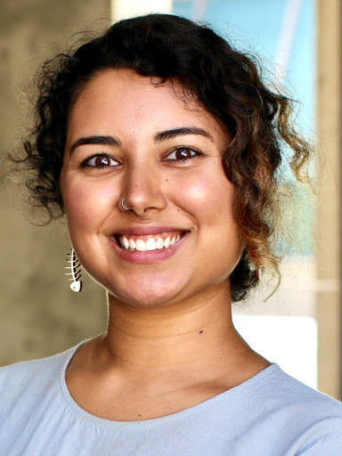
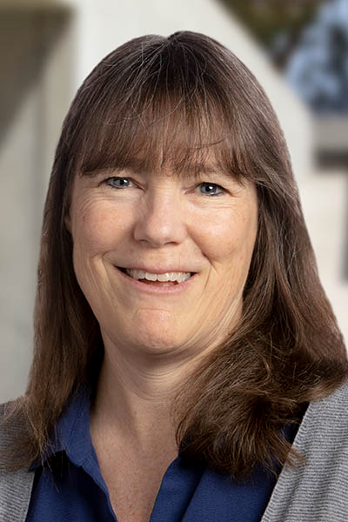
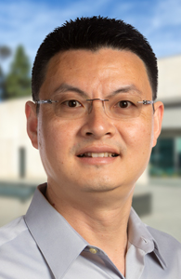
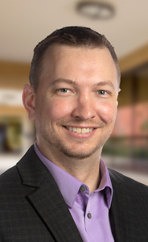
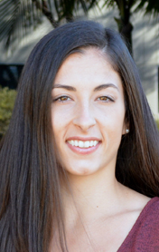
Consider the CBB graduate program track
*TA irrespective of track
CBB listserv, grown by ~200 individuals over the past year (300 total)
CBB track available to grad students since summer (currently 3 enrolled)
ABCB course (currently bi-annual)
Biostatistics (annual)
Advanced Methods
Advanced Techniques

Slide 13
Future Topics?
https://github.com/SuLab/Applied-Bioinformatics/tree/Fall-2018
https://github.com/SuLab/Applied-Bioinformatics/tree/Fall-2020

Slide 14
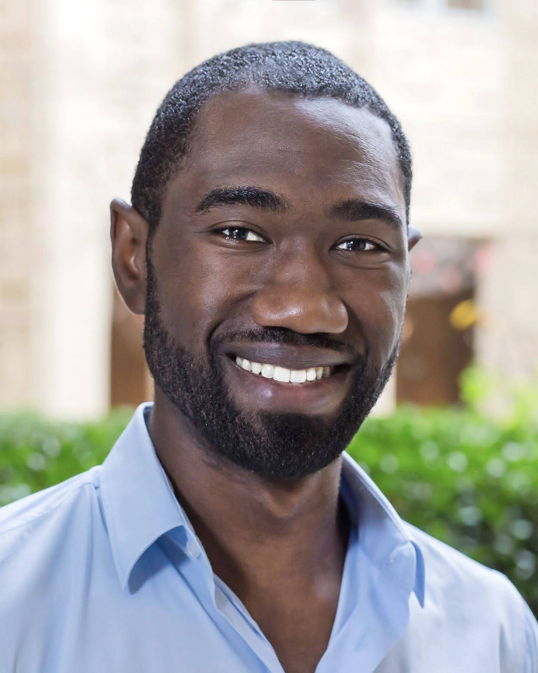
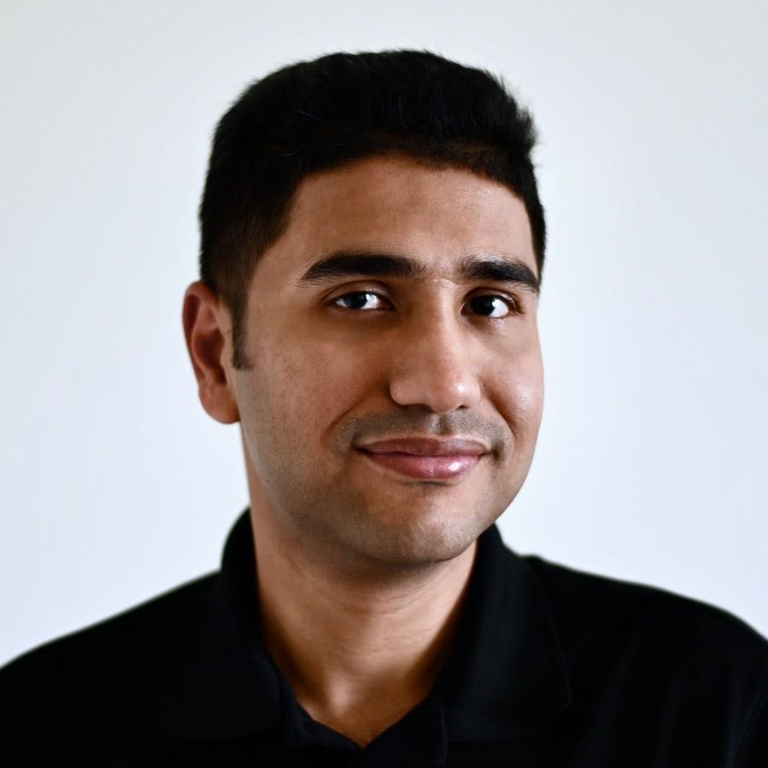
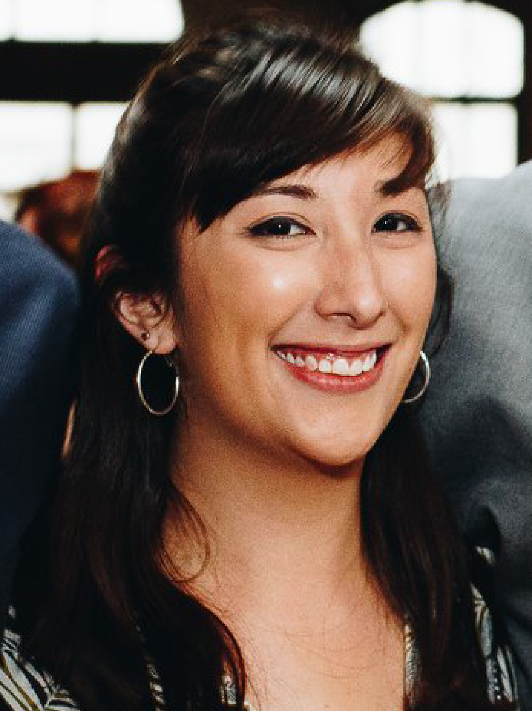
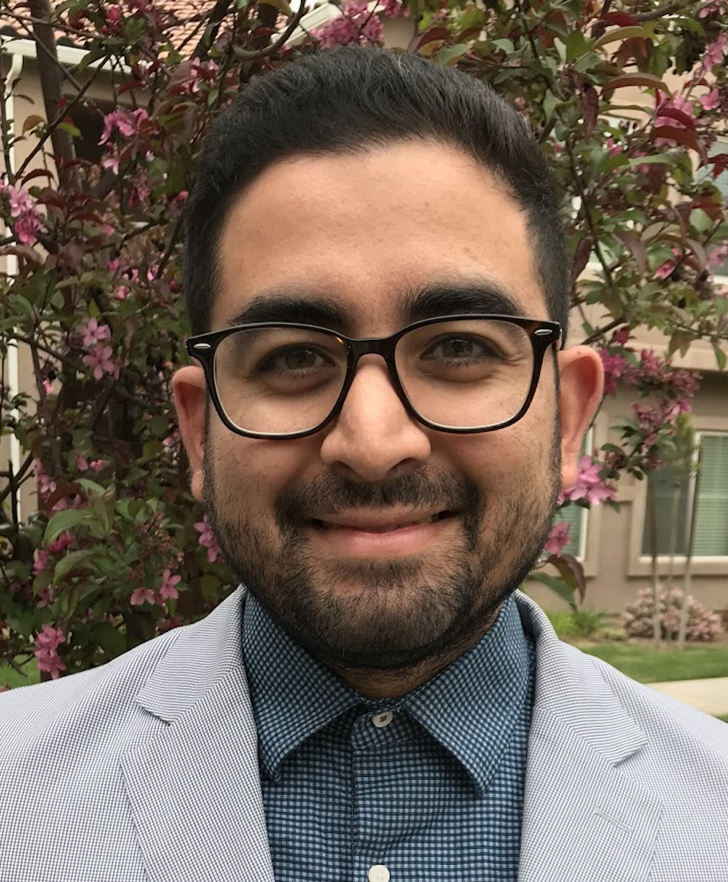
Immunology
UCSF
Microbiology NASA
Genomics NIH
Modeling
Fresno State
Tu
Th

Slide 15
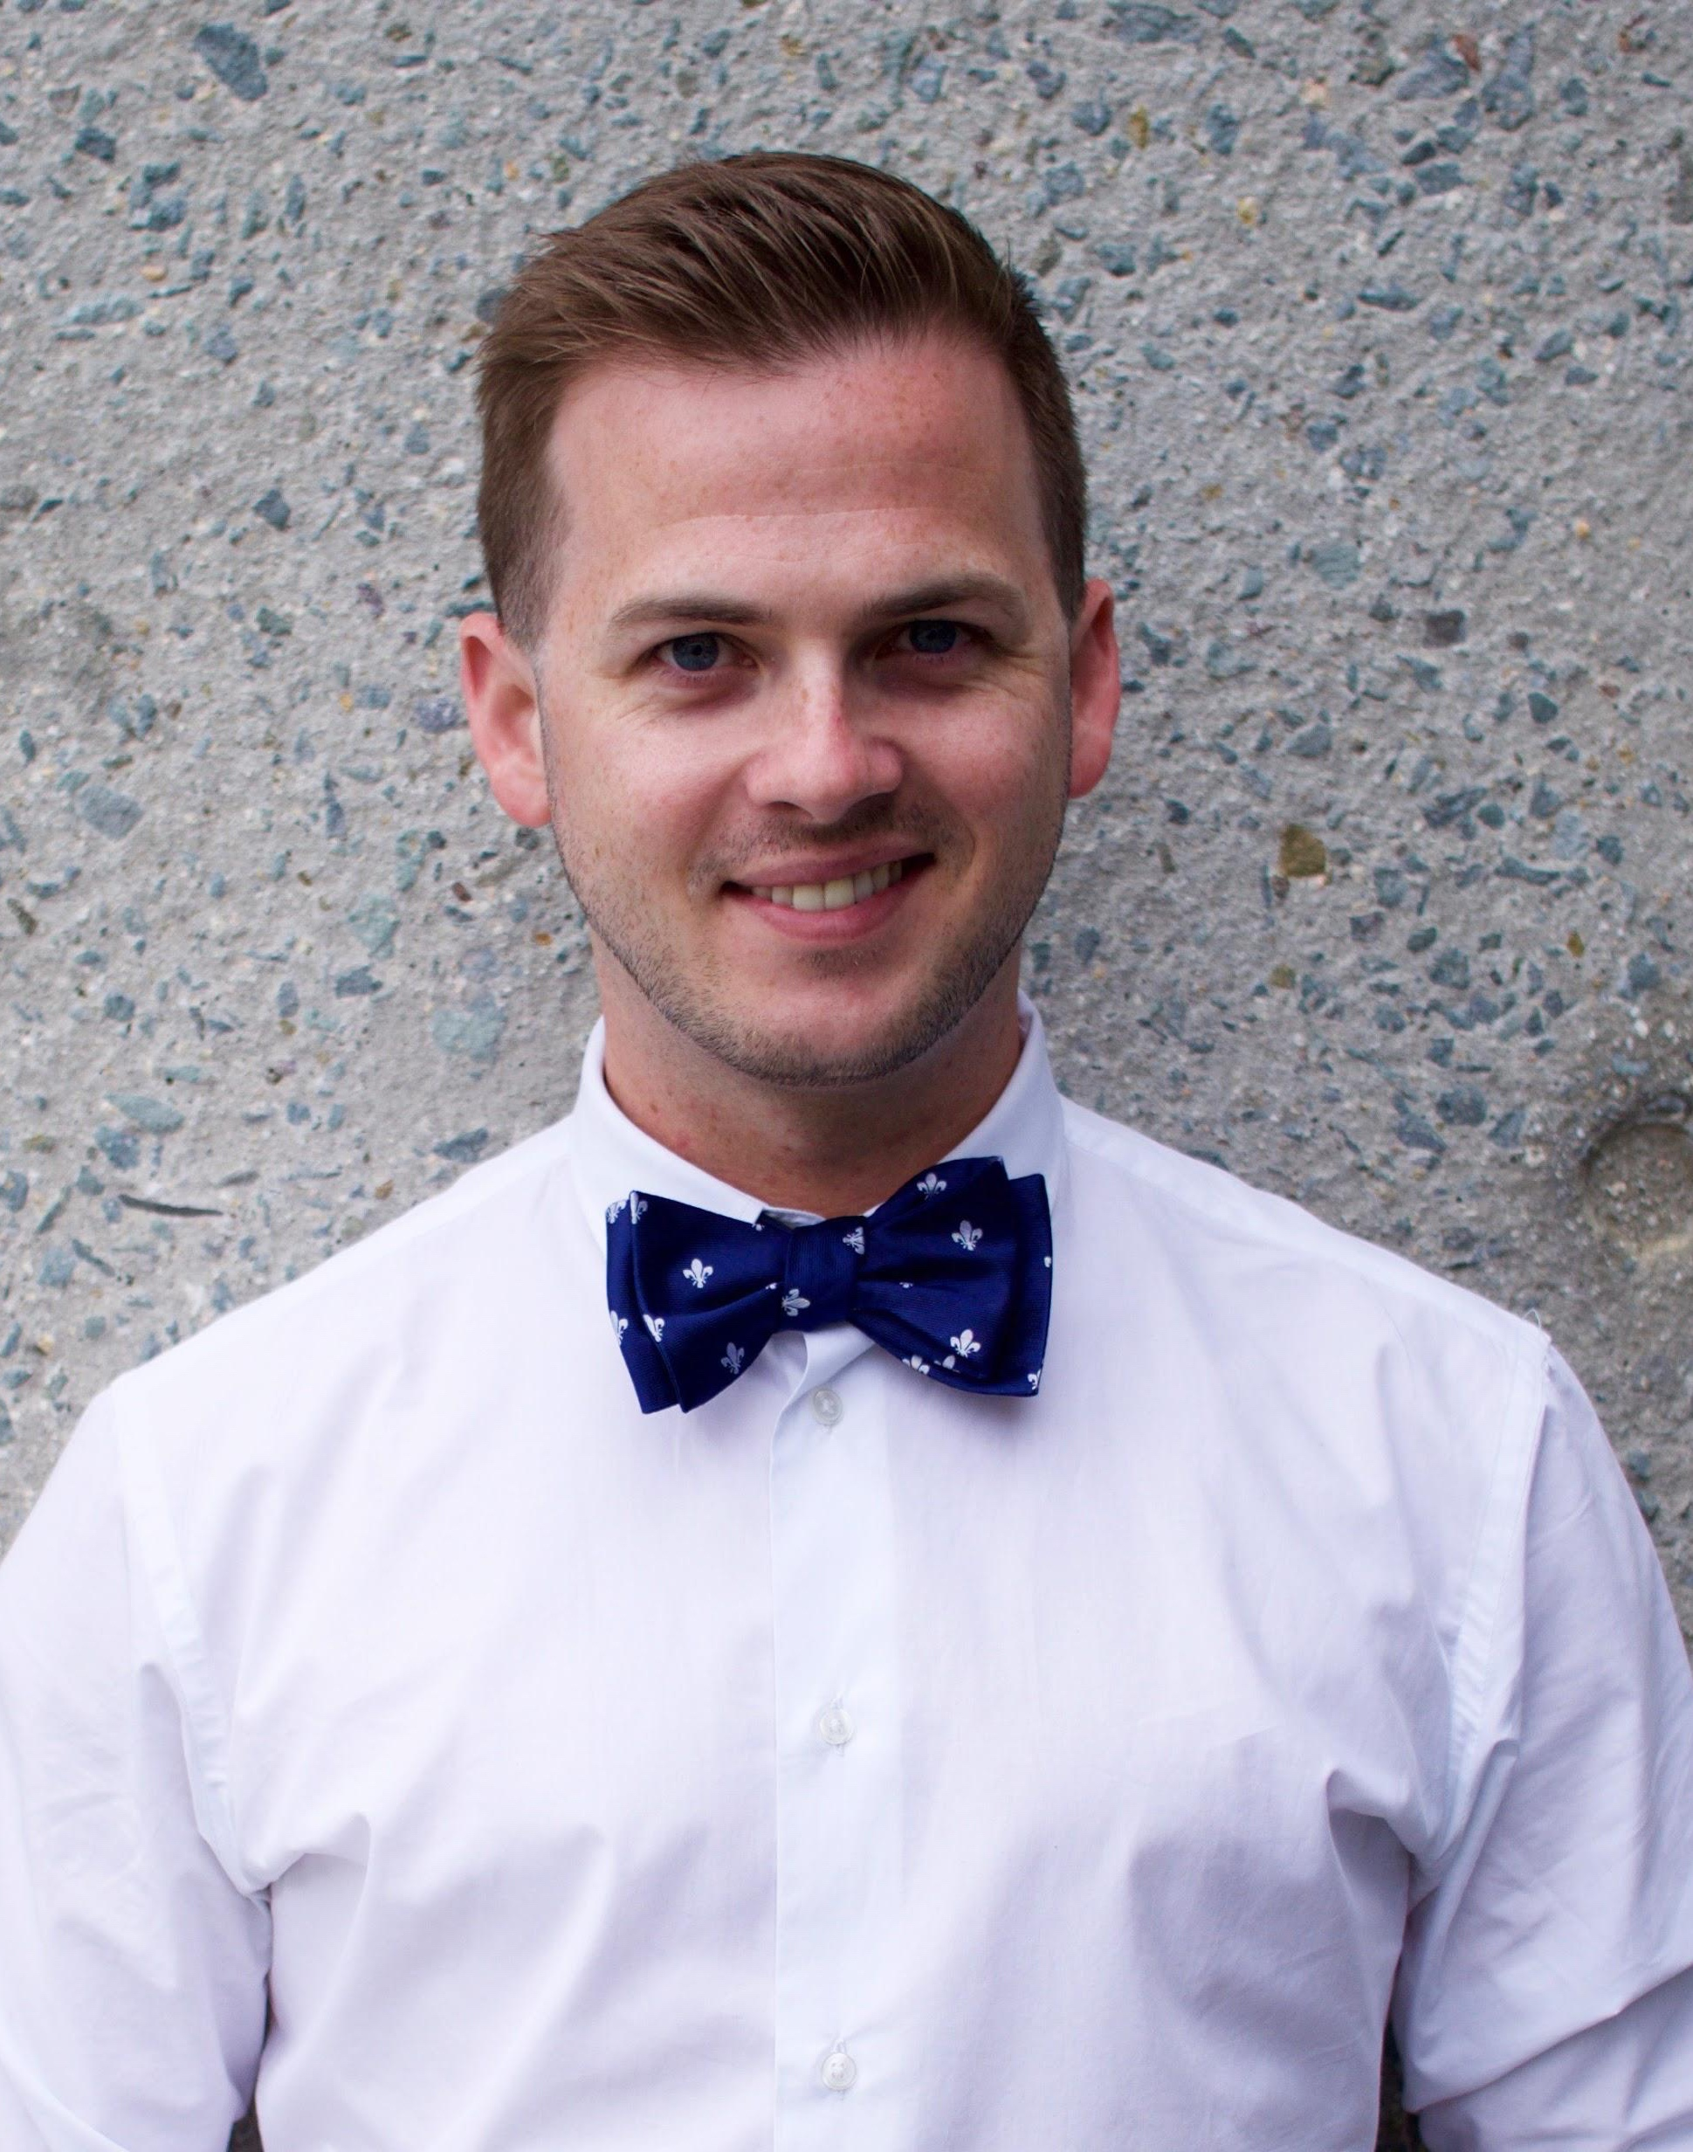
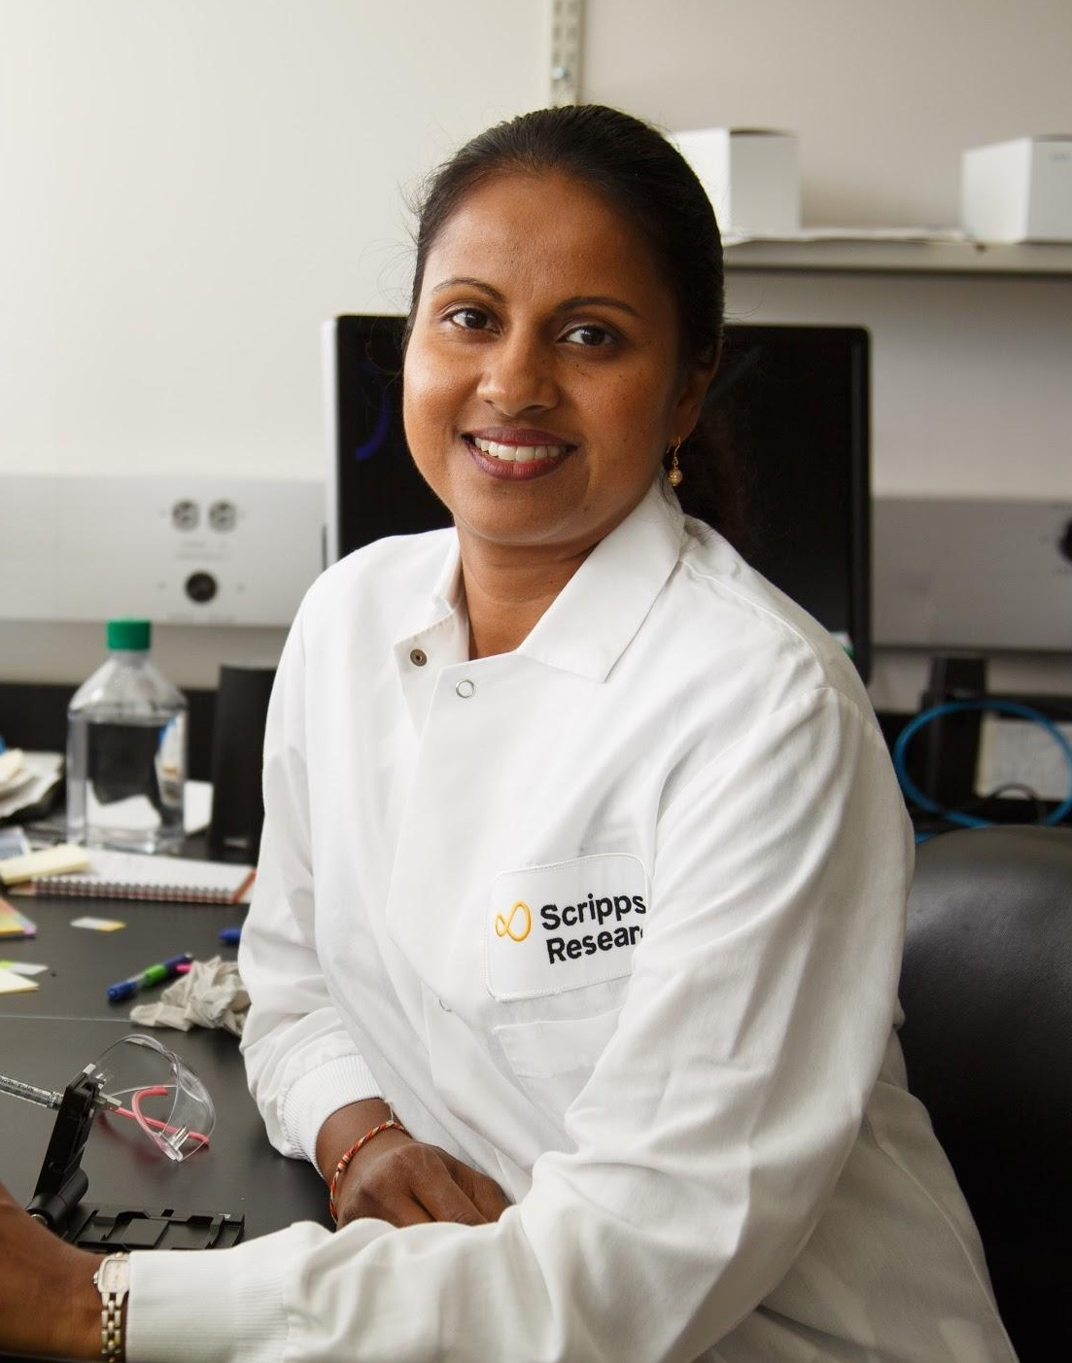
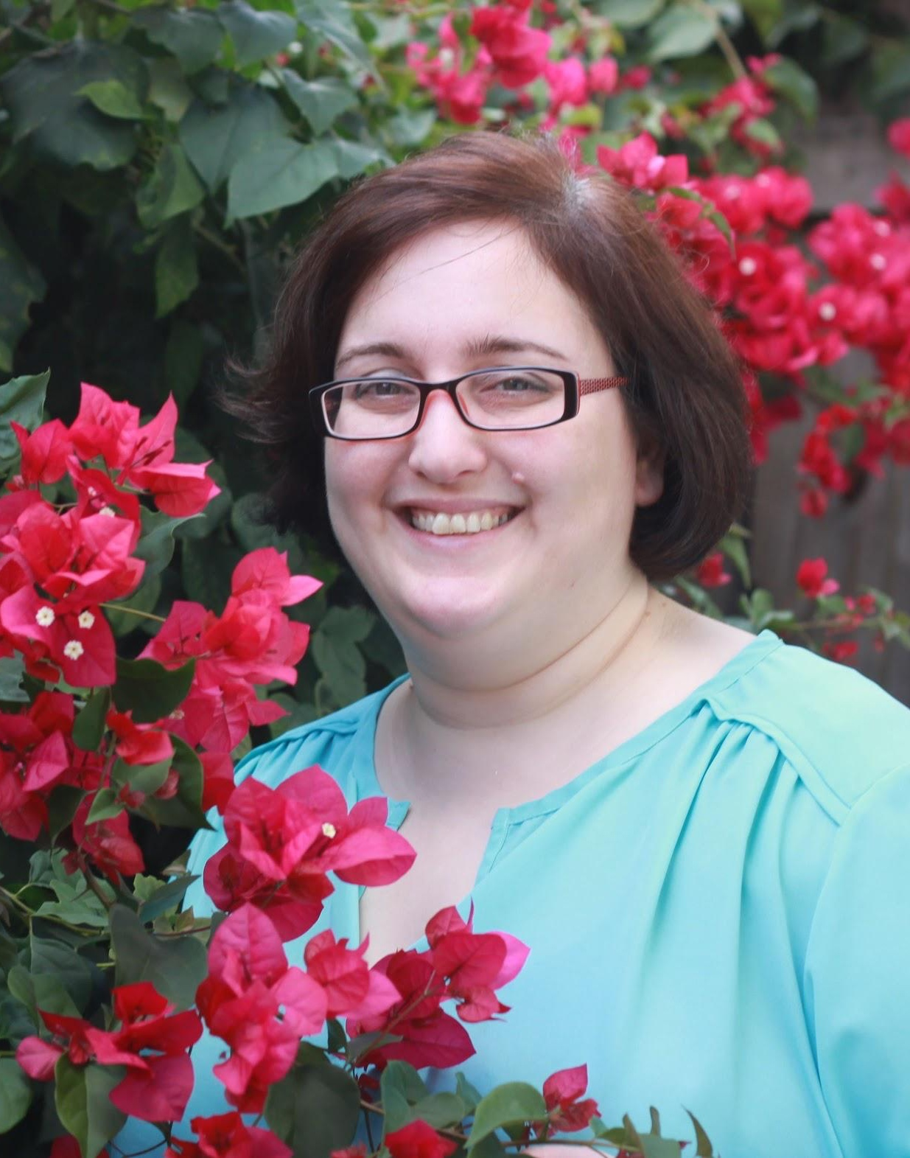
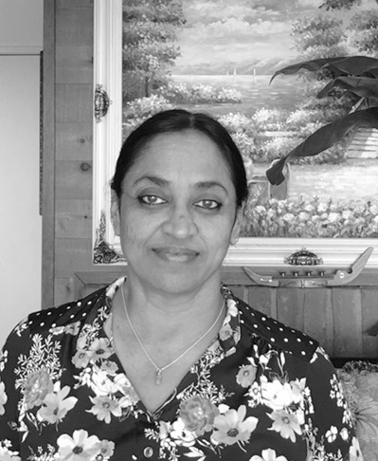
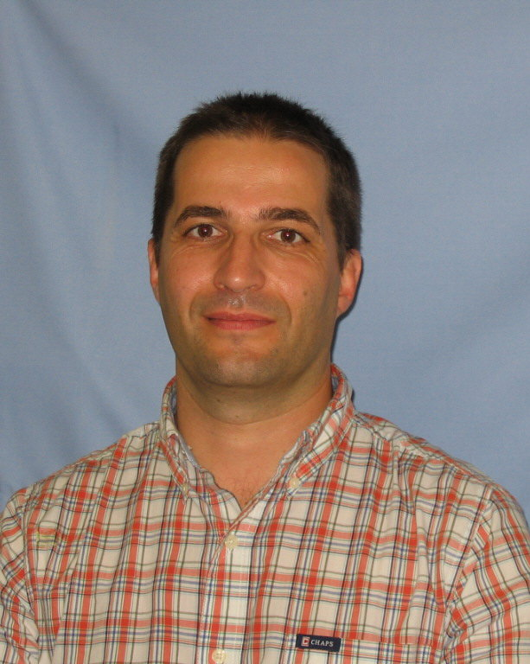
Immunology
UCSF
Microbiology NASA
Genomics NIH
Modeling
Fresno State
Tu
Th
Alumni, Postdoc
Core Director
FL Core Analyst
CA Core Analyst
HPC Director

Slide 16
Notes and Q&A
What you’d like to hear from panelists
Capstone (presentation dates)

